Slide 1
Natural statistics, memory, and the analogical proportion
Antal van den Bosch
Centre for Language Studies
Spinoza Long Tail Workshop
25 June 2016

Slide 2
types tokens

Slide 3
The Zipfian tail
where tokens become types

Slide 4
Computational models
It makes sense to be sensitive to tokens
  For voting, weighting, probability
  Count tokens
It makes sense to be sensitive to types
  Rare events in language are not noise
  Forgetting exceptions is harmful
Is there an account that is sensitive to both simultaneously?

Slide 5
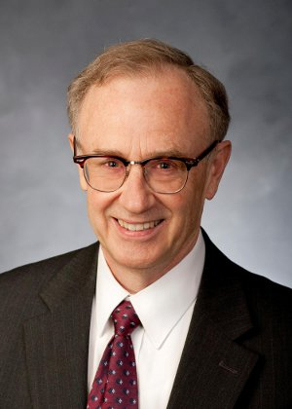
Royal Skousen
Brigham Young University (Provo, UT)
Ph.D. in linguistics (University of Illinois, Urbana-Champaign)
Taught at University of Texas at Austin, University of California at San Diego

Slide 6
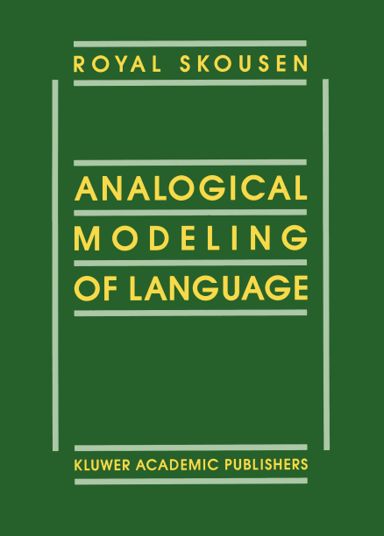
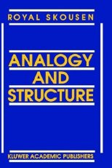
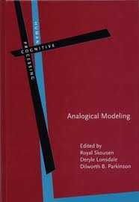
Analogical modeling

Slide 7
The model
=
The data

Slide 8
The model is the data
periphery
data
core
rules
analogy over exemplars
exceptions

Slide 9
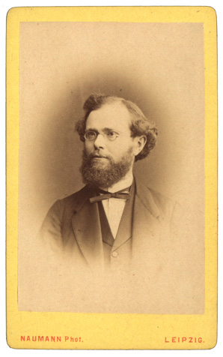
Hermann Paul (1846-1921)
"Die Wörter und Wortgruppen, die wir in der Rede verwenden, erzeugen sich nur zum Teil durch blosse gedächtnismässige Reproduktion des früher Aufgenommenen.
Ungefähr eben so viel Anteil daran hat eine kombinatorische Tätigkeit, welche auf der Existenz der Proportionengruppen basiert ist.
Die Kombination besteht dabei gewissermassen in der Auflösung einer Proportionengleichung, indem nach dem Muster von schon geläufig gewordenen analogen Proportionen zu einem gleichfalls geläufigen Worte ein zweites Proportionsglied frei geschaffen wird.
Diesen Vorgang nennen wir Analogiebildung."
(Prinzipien der Sprachgeschichte, 1920, p. 110)

Slide 10
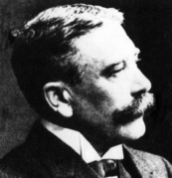
Ferdinand de Saussure (1857-1913)
Si c’est la quatrième proportionnelle qui prévaut, il est inutile de poser l’hypothèse de l’analyse. Il n’y a pas besoin de dégager préalablement des éléments comme in-, décor-, –able, pour créer indécorable mais il suffit de prendre le mot entier et de le placer dans l’équation
condamner : condamnable =
décorer : x,
x = décorable.
(CLG Engler, p. 228)

Slide 11
Saussurean Analogical Proportion
A:B :: A’:B’
A’
B’
/bEd/
/bId/
similar
maps to
maps to
=
bed
bid
similar
A
B

Slide 12
Quatrième proportionnelle
A:B :: A’:?
A’
/bEd/
?
similar
maps to
=
bed
bid
similar
A
B

Slide 13
Multi-neighbor version
sequence n’
sequence f’
?
sequence a’
are similar to
map to
sequence a
are similar to
sequence f
sequence b
sequence n

Slide 14
k-NN classification
Given k, the number of nearest neighbors captured in the neighborhood of the test example (hypercube/hyperball),
Produce a distribution of classes occurring in the hyperball
  Take the winning class
  Or, convert counts to probabilities
Local probability distribution

Slide 15
Analogical reasoning
Phil: selective abduction (e.g. Magnani, 1988)
  Likened to patient diagnosis
CompSci: k-nearest neighbor (Fix & Hodges 1951, Cover & Hart 1967)
  Local learning, lazy learning, case-based reasoning
CogSci: exemplar-based categorization (Nosofsky, Bybee)
  Single route learning, exemplars vs. rules
Psy: global memory matching (Hintzman 1984, Clark & Gronlund 1996)
  Episodic memory

Slide 16
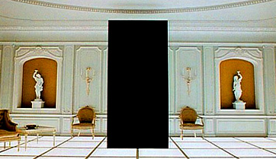
The significance of the single occurrence

Slide 17
Probabilistic vs natural statistics
Probabilistic account assumes control
  “Must add to 1.0”
  Associate numbers to symbols
  Perform smoothing, organize back-off models
  “One fundamental problem is the status of the probabilities: Do they actually exist?” (Skousen, 1989, p. 78)
Natural statistics: The data is the model
  Lazy approach
    Do nothing until new data comes to the model
    Reason temporarily, make prediction
    Probabilities can be assigned to these predictions if needed
    Forget prediction and return to do-nothing state
  Types matter
    Hapaxes matter

Slide 18
Probabilistic weirdness
The first mention of a word depends on its frequency, but the second does not.
Jelinek (1997), caching in LMs for ASR
  If recently seen, probability of a word is boosted
  Other words should be a little less probable
Church & Gale (1995), Poisson Mixtures, JNLE 1:2, pp. 163-190.
Church, K.W. (2000). Empirical estimates of adaptation: The chance of two Noriegas is closer to p/2 than p². In Proceedings of the 18th Conference on Computational Linguistics, pp. 180-186.

Slide 19
Mark Steedman’s self-critique
Steedman, M. (2008). On becoming a discipline. Computational Linguistics, 34:1, pp. 137-144.
  CL people: linguists are oblivious to Zipf’s law
  Linguists think the same about CL people!
  “It is we [CL researchers] who are at fault here, because the machine learning techniques that we rely on are actually very bad at inducing systems for which the crucial information is in rare events” (p. 3)

Slide 20
Function words
de het van een in ik te aan om en er die dat of zij wel wat dit ook is hij als op we dan uit zijn
Content words
doorfantaseren personages belangwekkende meezeulen betekenis langzamer tweedeling

Slide 21
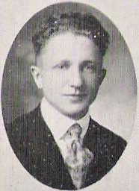
Zipf’s Law
George Kingsley Zipf (1902-1950)
Empirical law
  In words:
  rank number is inversely proportional to number of occurrences

Slide 22
Does Zipf’s Law hold?
Spoken (CGN)
Written (BD)
Rank | word | Zipf | actual
5 | en | 160.995 | 226.106
50 | naar | 16.100 | 32.564
500 | twaalf | 1.610 | 1.424
5.000 | vertrouwd | 161 | 76
50.000 | verhelderd | 16 | 3
Rank | word | Zipf | actual
5 | in | 1.077.832 | 1.333.512
50 | moet | 107.783 | 131.190
500 | men | 10.778 | 11.660
5.000 | uitermate | 1.078 | 1.014
50.000 | summum | 108 | 47

Slide 23
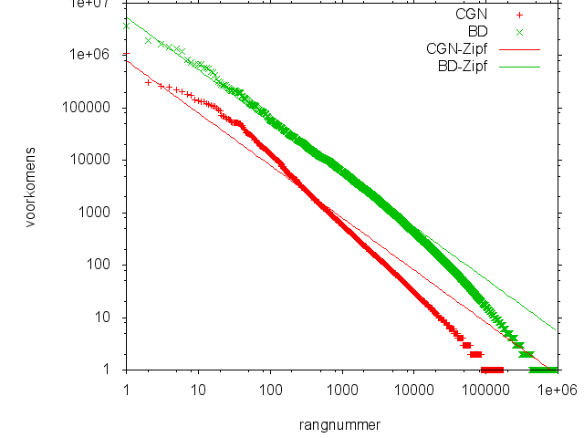
Does Zipf’s Law hold?
(The works of Ferrer y Cancho and Evert are great further reading)

Slide 24
Mandelbrot’s improvement
Zipf
Mandelbrot

Slide 25
Piantadosi’s analysis
S.T. Piantadosi. Zipf's law in natural language: a critical review and future directions. Psychonomic Bulletin and Review, in press.

Slide 26
Heaps’ Law
Harold Stanley Heaps (1978). Information Retrieval: Computational and Theoretical Aspects. Academic Press. (pp. 206–208)

Slide 27
Heaps’ Law
Seeing a text of n words,
You will have seen V(n) unique words
K and β are language-specific constants
  For English:
    10 < K < 100
    0.4 < β < 0.6
Spoken (CGN):
K = 20, β = 0.59
Written (BD):
K = 90, β = 0.47

Slide 28
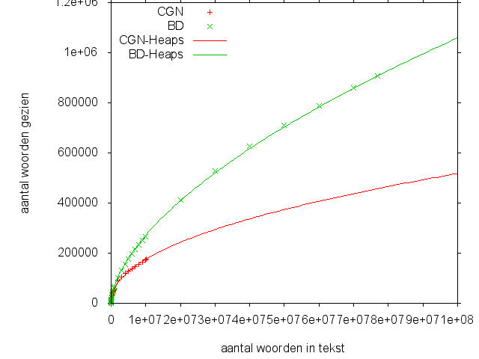
Heaps and CGN/BD

Slide 29
The lesson of Zipf and Heaps
The more text,
  The more occurrences of the same word
  The more new words
  The better the expectations (log-linear improvement)
From experimenting we learn that
  Low-frequency examples are not noise

Slide 30
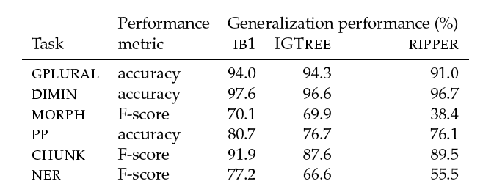
Eager (Ripper) never outperforms Lazy (TiMBL)
W. Daelemans, A. van den Bosch, and J. Zavrel (1999). Forgetting exceptions is harmful in language learning. Machine Learning, 34, pp. 11--43.

Slide 31
Word sense disambiguation: “line”
Similar: little, make, then, time, …
Ripper
TiMBL
Default
21.8
20.2
Optimized parameters
22.6
27.3
Optimized features
20.2
34.4
Optimized parameters + FS
33.9
38.6

Slide 32
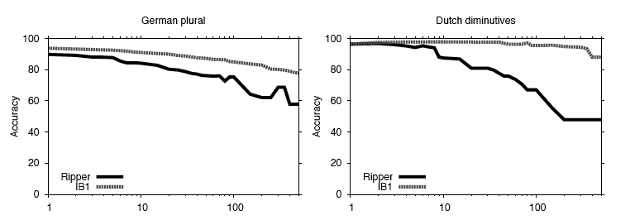
Abstraction hurts
Increasing coverage

Slide 33
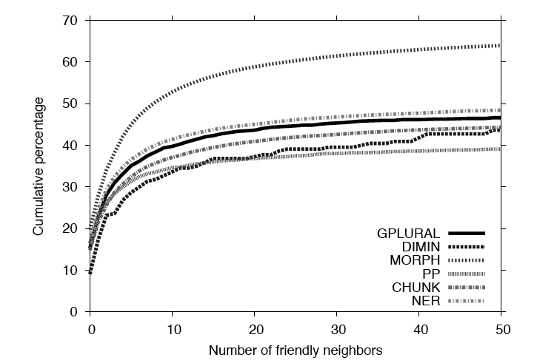
High class disjunctivity in feature space
Notes:
e.g. morphology, more than half of the instances have fewer than 10 friendly neighbours
All datasets: 10 to 20% of the instances have NO friendly neighbour

Slide 34
Abstract over instances?

Slide 35
FamBL: Family-based learning

Slide 36
Fambl with k=1 versus normal k-NN
Possible without damaging performance
The ‘k’ parameter is compiled away

Slide 37
Abstracting over instances
Possible to some degree without damaging performance
The ‘k’ parameter is learned locally

Slide 38
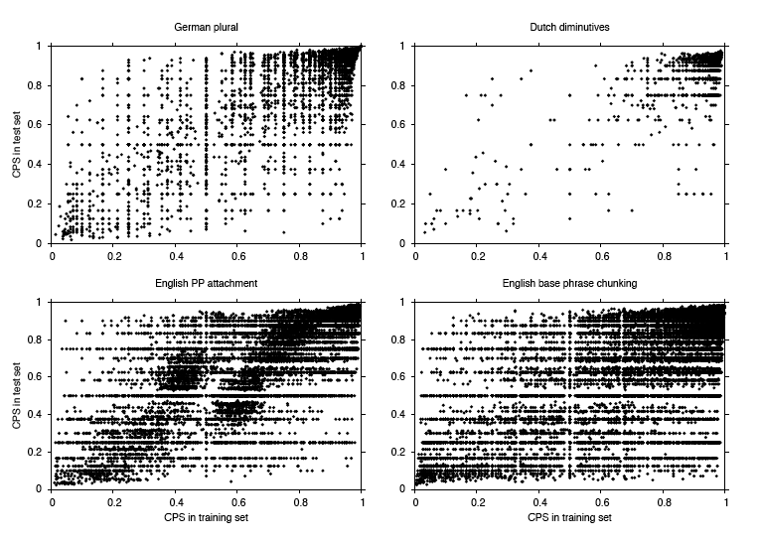
How useful are exceptional examples?
(Class Prediction Strength)
Notes:
Cps = kind of training item precision. How many times was it used as a nn, and of those, how many times ‘correct’ (class is same as target). Leave one out.
Dots are one or more training items.
(Exceprtionality = cps)

Slide 39
Lessons
Engineering
  Forgetting exceptions is harmful
Cognitive modeling
  Exemplars & analogical reasoning
    Construction grammar
    Memory
  Language acquisition
  The predictive brain

Slide 40
long live the type!

