Slide 1
Filling the Long Tail
Eduard Hovy
Carnegie Mellon University
www.cs.cmu.edu/~hovy

Slide 2
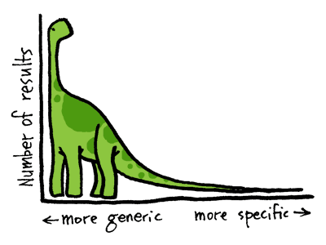
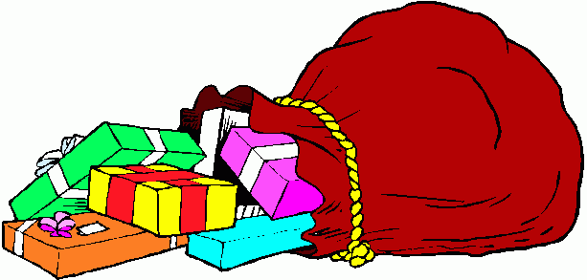

Slide 3
Example: Webclopedia QA
Webclopedia (Hovy et al. 01)
Where do lobsters like to live?
— on the table
Where are zebras most likely found?
— in the dictionary
How many people live in Chile?
— nine
What is an invertebrate?
— Dukakis

Slide 5
Why?
Today: illusion that NLP systems ‘understand’ through
  clever problem decomposition
  use of resources like WordNet, online dictionaries, PropBank…
To do more than surface-level transformation, systems need to ‘understand’
The Long Tail is full of phenomena required for understanding

Slide 6
What can NLP do well today?
Surface-level preprocessing (POS tagging, word segmentation, NE extraction, etc.): 97%+
Shallow syntactic parsing: 94%+ for English (Charniak, Collins, Lin) and deeper analysis (Smith)
IE: ~60% for well-behaved topics (MUC, ACE)
Speech: ~80% large vocab; 40%+ open vocab, noisy input
IR: 45%+ (TREC)
MT: ~70% depending on what you measure
Summarization: ? (~60% for extracts; TAC)
QA: ? (~60% for factoids; TREC)
00s–
00s–
80s–
80–90s
80–90s
00s–
90–00s
00s–

Slide 7
What can NLP not do today?
Do general-purpose text generation
Deliver long/complex answers
  e.g., extracting, merging, and summarizing web info
Handle extended dialogues
Read, remember, and learn (extend own knowledge)
Use pragmatics (style, emotion, user profile…)
Deliver semantics—either in theory or in practice
  (not even semantic analysis of multiple sentences)
Contribute to a theory of Language (in Linguistics or Neurolinguistics) or Information (in Signal Processing)
etc…

Slide 8
Why? Maybe because
NLP still works at the word level
Most NLP is notation transformation:
  IF [word and/or features] → [transformed result]
  Features: part of speech label (noun, verb…), semantic type (person, location…), simple sentiment value (pos, neg…), etc.
Statistics / machine learning is currently the main paradigm
Too little thinking about semantics
  Most work is algorithm hacking or small-problem exploration (the HOW, not the WHY)

Slide 9
So if the answer is ‘semantics’,
which aspects of semantics?
How many aspects?
How do we acquire the knowledge?

Slide 10
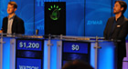
Semantics in IBM’s Watson QA system
~2006: IBM tackled the problem of QA
In 55 real-time test games against former Jeopardy! champions, Watson won 71%
About 105 subdomain specialists

Slide 11
Watson’s incremental progress in Precision and Confidence
Slide from IBM
11/2010
4/2010
10/2009
5/2009
12/2008
8/2008
5/2008
12/2007
Precision
Baseline
Notes:
11

Slide 12
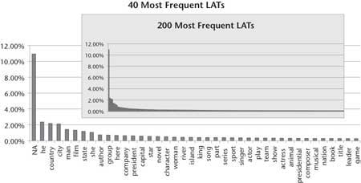
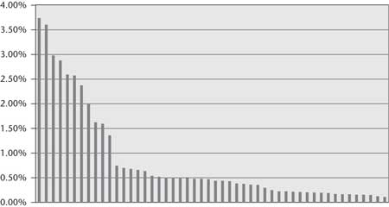
Watson’s Lexical Answer Types
(Watson team online)
Found 2500 distinct explicit LATs in 20,000 questions
  Most frequent 200 explicit LATs cover less than 50% of the data
Using many independent answer-typed algorithms:
  Most use own type system
  “The best way to integrate preexisting components is not to force them into a single, common type system, but to have them map from the LAT to their own internal types”
Approximate distribution of the 50 most frequent Freebase relations in 20,000 randomly selected Jeopardy! clues:

Slide 13
Single-doc QA
(Weston et al. 2015)
Weston et al. (2015): Towards AI-complete Question Answering: A Set Of Prerequisite Toy Tasks
Classify understanding and reasoning tasks into skill sets:

Slide 14
Jerry Hobbs bought the green Toyota yesterday
He and the seller were both happy
(e1 :type Action :act buy
:agent (x0 :type Person :name “Jerry Hobbs”)
:patient (x1 :type Car
:make “Toyota”
:color (x2 :type Color :value green))
:price [$2000 – $25000]
:time (x3 :type Time :value yesterday))
What is to ‘buy’?
Who is Jerry Hobbs?
What is ‘green’?
What price range?
Who’s this ‘seller’?
Why is he happy?
Cause
(e2 :type Happiness-state
:experiencer {x0, seller}
:value high)
(x4 : type Person (“seller”))

Slide 15
The general and the specific
Microtheories: General
  Location: point/region, spatial inclusion…
  Time: point/interval, typical event lengths…
  Coref: various types of partial identity
  Numerical info: typical value ranges
  Role fillers: semantics and metonymy
  Background knowledge: facts
  Background knowledge: concepts, inheritance, and concept facets
Micro-contexts: Specific
  Composed structures: goals, plans, scripts…
  Instantiated subsets (terms & microtheories)
  Specific coref/concept facets: various types of partial identity
  Change over time
Variations just of:
Time/Loc/Depiction/
Role/Substep…
Normal or
anomalous
events
Multiple
inheritance, Perspective

Slide 16
Too many!
So, focus on enabling techniques…
Goyal et al. 2013
Srivastava 2014
Xue and Hovy 2016
Discrete rep symbols —> Continuous tensors/embeddings
Latent relations
Special-purpose micro-‘theories’ for
  Numbers
  Locations, dates, times, etc.
  Social roles, etc.
  etc.
Dynamic collections of background facts & concepts
Semantic compositionality (to smoothly integrate individual discrete representation fragments):
  Role filler constraints / selectional preferences
  Property-based compositionality
  Anomaly detection
Faruqui et al. 2015
Jauhar and Hovy 2015
Peñas and Hovy 2010
Kozareva et al. 2010
Goyal et al. 2013
Dasigi and Hovy 2014
Jauhar and Hovy

Slide 17
Steps to define the semantics
Word/sentence/topic or concept?
Words or concepts?
buy1 = {[agent: (PER 0.6) (ORG 0.4) (Mary 0.11) …]
[patient: (dress 0.5) (car 0.2) (house 0.09) …]
[seller: (shop 0.2) (dealer 0.3) …]
[price: ($NUM 0.3) (bargain 0.11) …]
…}
Grammatical or semantic roles?
‘Strength’ or probability?
How to compose and propagate values?
EVENT1 = { [type: buy1]
[agent: Hobbs15]
[patient: X3]
[price: $NUM]
…}
X3 = {[type: (CAR1 1.0)]
[make: (“Toyota” 1.0)]
[color: (green 1.0)]
[model: (“Prius” 0.3) (“Corolla 0.2) …]
…}

Slide 18
Desiderata for semantics reps
Each rep unit must be well-defined
What are the facets of Person?
What are the facets of Buy?
Each rep unit must have a single constant meaning
How to denote this in the world?
Each meaning should have only one rep unit
No ambiguity
The simplest rep units are symbols with denotations (meanings)
2, π, Person, yesterday, high
Symbols must be composable into larger configurations, for which you can also assign symbols
How to guarantee correctness?

Slide 19
Talk overview
Introduction
Factual knowledge (A-Box)
Conceptual knowledge (T-Box)
Higher-level concepts and abstractions
Conclusion and thoughts from today’s talks

Slide 20
Factual knowledge to support inference

Slide 21
The DEFT program
DARPA program, in year 4 of 6:
  Teams from all over the country
  BBN assembles the software in its ADEPT system; downloadable
  Follows prior Machine Reading Program (MRP)
Goals: Machine Reading for Knowledge Base Population (KBP)
  Component technologies and evaluations:
    Parsing, entity detection, entity linking, entity and event coref, event mention detection, event relation extraction, slot-filling, KBP from scratch (= “Cold Start”)
  Languages: English, Chinese, Spanish
  Training data from LDC; all kinds of useful stuff
  Evaluations run by NIST: annual TAC conference

Slide 22
SAFT project: Hypothesis of our work
When you read a [set of] text[s],
you don’t just do sentence-based frame-level analysis;
you use various kinds of external knowledge
that support one another in complex ways
and apply various additional processes
to produce a richly interconnected result, with predictions and explanations.

Slide 23
An example from MRP
William Floyd rushed for three touchdowns and Steve Young scored two more, moving the San Francisco 49ers one victory from the Super Bowl with a 44–15 football rout of Chicago.
Chicago struck first, recovering a fumble to set up a 39-yard Kevin Butler field goal for a 3–0 lead just 3:58 into the game. But nothing went right for the Bears after that. The 49ers moved ahead 7–3 on Floyd’s two-yard touchdown run 11:19 into the game.
San Francisco’s Eric Davis intercepted a Steve Walsh pass on the next series to set up a seven-yard Young touchdown pass to Brent Jones.

Slide 24
Example knowledge gaps
Two more what?
How do you ‘rush for a touchdown’? Is that the same as ‘make a touchdown?’ Or as ‘drop a touchdown attempt’?
What is the connection between San Francisco and the 49ers? And with Floyd?
How do you ‘move one victory’? How do you ‘move it from the Super Bowl’?
What is a ‘two-yard touchdown’? Is this how far you move?
What is a ‘Steve Walsh pass’?
What is a ‘Young touchdown pass to Brent Jones’?
William Floyd rushed for three touchdowns and Steve Young scored two more, moving the San Francisco 49ers one victory from the Super Bowl with a 44–15 football rout of Chicago.
But nothing went right for the Bears after that.
The 49ers moved ahead 7–3 on Floyd's two-yard touchdown.
San Francisco’s Eric Davis intercepted a Steve Walsh pass on the next series to set up a seven-yard Young touchdown pass to Brent Jones.

Slide 25
ISI’s knowledge support service
We are building a general ‘knowledge support service’
Proposition Store: A large general world model, and/or specialized domain models:
  Lexical and semantic ‘connotation knowledge’ for content words
  Model can be tailored to each new domain for rapid (though averaged) semantic predictions
Uses: Bridge various kinds of knowledge gaps:
  Unknown words/phrases — specialist domain language problem
  Unclear reference — coref problem
  Missing fillers — assumed-knowledge problem
  Missing inter-proposition relations — term connection problem
  Unknown named entities — sparsity problem
Methods:
  Providing generalizations of named entities
  Providing semantic preferences for parsing, interpretation, inference
  ‘Funneling’ expressive variations into preferred terms
  Reranking inference preferences to improve performance speed

Slide 26
MR text enrichment cycle
Rumination
Knowledge Discovery
Proposition Store
Domain
Docs.
Reading
Enrichment
Cycle:
Read text from collection
Ruminate in PropStore
Enrich text and store
Repeat

Slide 27
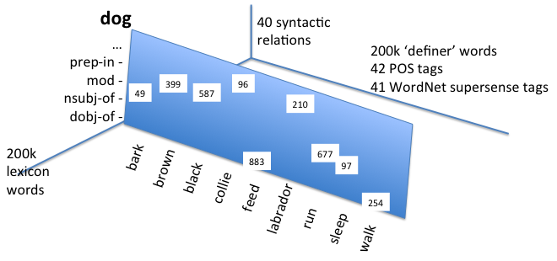
Background knowledge: The PropStore
Goyal et al., ACL 2013
PropStore: simple triple store
Can extract arbitrarily complex structures with counts
Build: Parse sentences, [do coref], extract head noun of each syntactic role, save triple (with pointers), at end group together by role
Contents:
  Words, lemmas, supertags, POS tags
  [words x words x syntactic relations]
  Current size (English): ~4 billion triples in 800 databases (~2TB)
  Multiply indexed for rapid retrieval and vector/tensor assembly

Slide 28
PropStore statistics, 2016
The PropStore: A triple store in 3 languages from Wikipedias:
  Fast, well-implemented
  English (wikipedia size = 9.2 GB):
    dictionary 9.736.628
    triples (approx.) 191.255.059
    triples occurrences (approx.) 1.825.690.862
    Corresponding to: 4.673.942 documents, containing 87.923.068 sentences
  Spanish (wikipedia size = 2.3 GB):
    dictionary 3.571.805
    triples (approx.) 60.414.469
    triples occurrences (approx.) 444.864.366
    Corresponding to: 1.103.688 documents, containing 18.556.523 sentences
  Chinese (wikipedia size = 0.6 GB):
    dictionary harder to quantify because of character-based writing
    triples (approx.) 15M
    triples occurrences (approx.) 100M
    Corresponding to: approx. 0.3M documents containing 4.5M sentences
Plan to use to augment entity and event information in reading

Slide 29
Proposition Stores at ISI
Various Machine Reading project domains:
  NFL: 30,000 docs (1,000,000 sentences)
  IC: 200,000 docs (~6,500,000 sentences)
  BIO: 75,000,000 sentences (all PubMed abstracts)
  General: 220 million triples (6.3GB compressed to 517.7MB)
    Triple types: 50,840,754
    Triple count sum: 461,941,244
    About 30 relations (all syntactic): DOBJ, etc.
    Source corpus: 50,000,000+ sentences from New York Times
Various formats:
  Raw parse tree triples
  Nested role fillers (modifiers) for each head
Machinery to rapidly build new ones
Large central Store and access machinery being built at CMU
IBM’s PRISMATIC (from 30 gb text: over 1b propositions)

Slide 30
PropStore construction
3 pass Jones Walsh
4 pass Floyd Davis
12 pass quarterback end
1 pass Marino Floyd
…
8 drop _ Walsh
11 drop _ Davis
…
Take a lot of domain text
Parse every sentence (dependency parse)
(Convert the syntactic and prep relations to semantic ones)
Cut up the dependency tree into [Head-Rel-Mod] triples
(If needed, combine triples into longer propositions)
Save every triple/prop in a large Store:
  [rel head mod 1 doc-id sent-id]
When done, add together all identical triples/props:
  [rel head mod total ((doc-id₁ sent-id₁) (doc-id₂ sent-id₂) …)]
(Regroup as needed (e.g., sort under the heads):
  [head (rel (mod₁ total₁) (mod₂ total₂) …) ((doc-id₁ sent-id₁)…)]
  (rel (mod₁ total₁) (mod₂ total₂) …) ((doc-id₁ sent-id₁)…)] )

Slide 31
Using the knowledge service
Example: San Francisco's Eric Davis intercepted a Steve Walsh pass on the next series to set up a seven-yard Young touchdown pass to Brent Jones.
Implicit | (More) explicit
San Francisco’s Eric Davis | Eric Davis plays for San Francisco
Eric Davis intercepted pass | —
Steve Walsh pass | Steve Walsh threw pass Steve Walsh threw interception
Young touchdown pass | Young completed pass for touchdown
touchdown pass to Brent Jones | Brent Jones caught pass for touchdown
These are inferences on the language side

Slide 32
Example: Queries to football PropStore
?> NPN 'pass':X:'touchdown‘
NPN 712 'pass':'for':'touchdown'
NPN 24 'pass':'include':'touchdown’
…
?> NVN 'quarterback':X:'pass'
NVN 98 'quarterback':'throw':'pass'
NVN 27 'quarterback':'complete':'pass‘
…
?> NVNPN 'NNP':X:'pass':Y:'touchdown'
NVNPN 189 'NNP':'catch':'pass':'for':'touchdown'
NVNPN 26 'NNP':'complete':'pass':'for':'touchdown‘
…
?> NVN 'end':X:'pass‘
NVN 28 'end':'catch':'pass'
NVN 6 'end':'drop':'pass‘
…
?> NN NNP:’pass’
NN 24 'Marino’:'pass‘
NN 17 'Kelly':'pass'
NN 15 'Elway’:'pass’
…
?>X:has-instance:’Marino’
20 'quarterback':has-instance:'Marino'
6 'passer':has-instance:'Marino'
4 'leader':has-instance:'Marino'
3 'veteran':has-instance:'Marino'
2 'player':has-instance:'Marino'

Slide 33
Enrichment example: 1
…to set up a 7-yard Young touchdown pass to Brent Jones
Young
touchdown
Jones
nn
nn
to
pass
Young pass
  ?> X:has-instance:Young
    X=quarterback
  ?> NVN:quarterback:X:pass
    X=throw
    X=complete
Pass to Jones
  ?> X:has-instance:Jones
    X=end
  ?> NVN:end:X:pass
    X=catch
    X=drop

Slide 34
Enrichment 2
…to set up a 7-yard Young touchdown pass to Brent Jones
Young
touchdown
Jones
throw
complete
nn
catch
drop
pass
touchdown pass
  ?> NVN touchdown:X:pass
    False
  ?> NPN pass:X:touchdown
    X=for

Slide 35
Enrichment 3
…to set up a 7-yard Young touchdown pass to Brent Jones
Young
touchdown
Jones
throw
complete
for
catch
drop
pass
  ?> NVNPN NAME:X:pass:for:touchdown
    X=complete
    X=catch

Slide 36
Enrichment 4
…to set up a 7-yard Young touchdown pass to Brent Jones
Young
touchdown
Jones
complete
for
catch
pass
Young complete pass for touchdown
Jones catch pass for touchdown

Slide 37
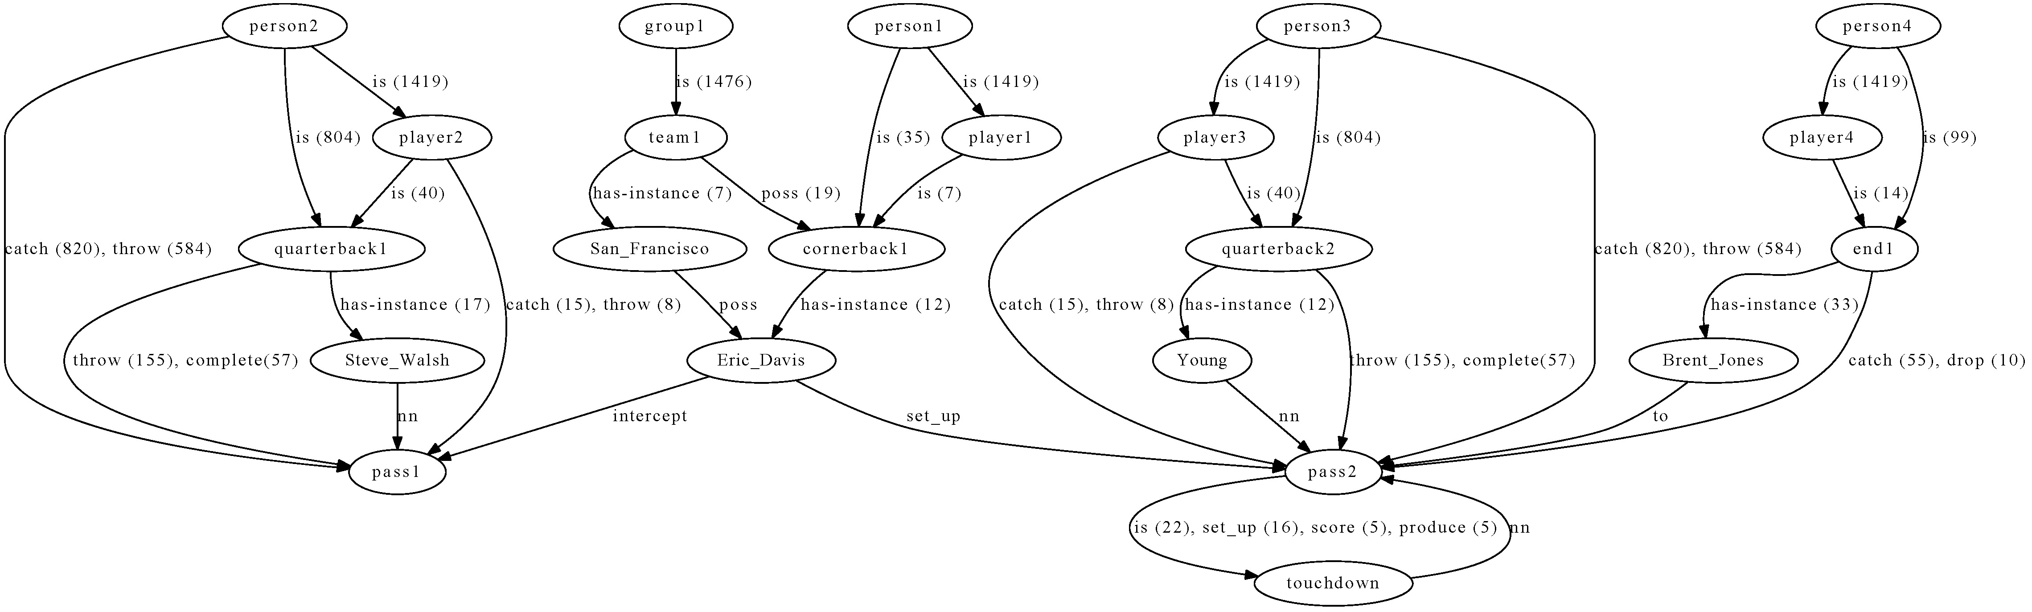
Example enrichment result
San Francisco's Eric Davis intercepted a Steve Walsh pass on the next series to set up a seven-yard Young touchdown pass to Brent Jones.
Before enrichment
After enrichment

Slide 38
Factual knowledge
Our systems don’t remember what they read a minute ago!
Decomposing input into minimal units allows easy confidence scoring and inconsistency/novelty discovery
…this sets up the ‘knowledge frontier’ — the things about which the system should want to know more
This provides the reader with curiosity

Slide 39
Obtaining and Organizing
Conceptual knowledge

Slide 40
A challenge: learning ontologies
Given a domain, can we from the web learn its structure (metadata) and instances simultaneously?
That is, can we learn…
  instance/basic level terms?
  non-instance terms and their organization?
  …with no (or minimal) supervision, using automatic knowledge acquisition methods, all together (so one type helps the other)?

Slide 41
Example
Animal
Mammal
Sea Mammal
Carnivore
Living Being
Herbivore
Rodent
Cat
rabbit
dolphin
lion

Slide 42
Approach and definitions
Start with instances / basic level terms
Then learn non-instance / organizational terms
Then taxonomize, in stages
Term: English word
Concept: Any item in classification taxonomy
Class: Concept in taxonomy, but above Basic Level
Basic level concept: Concept at Basic Level in Prototype Theory (Rosch 78): dog (not mammal or collie); car (not vehicle or ‘BMW 520i’)
Instance: More precise than a concept: single individual entity (Lassie, Aslan; ‘BMW 520i with reg EX740N’)

Slide 43
Step 1: Instances
(Past text mining work)
Initial work (Hearst 1992): NP patterns signal hyponymy:
NP0 such as NP1, NP2…
NP0, especially NP1…
NP0, including NP1, NP2, etc.
Later work using different patterns for different relations
  part-whole (Girju et al. 2006)
  named entities (Fleischman and Hovy 2002; Etzioni et al., 2005)
  other relations (Pennacchiotti and Pantel, 2006; Snow et al., 2006; Paşca and Van Durme, 2008), etc.
Early work learned just terms; later work learned patterns and terms together
Main problem: classes are small, incomplete, and noisy

Slide 44
Doubly-Anchored Patterns
(Kozareva et al. ACL 08)
Define doubly-anchored pattern (DAP):
[ NP0 such as NP1 and ? ]
Collect terms:
animals such as lions and *
using algorithm ‘reckless bootstrapping’:
  Start with seed terms NP0 and NP1,
  learn more terms in position *: NP2, NP3, …
  Then, replace NP1 by NP2, NP3 ,… , and learn more NPi
  … repeat

Slide 45
DAP greatly reduces ambiguity
Virtually eliminates ambiguity, because class_name and class_member mutually disambiguate each other
  such as
Not perfect, though:
English
C++
languages
and Spanish
Java
Spanish

Slide 47
Comparison with past work
(Paşca et al., 2007)
KnowItAll (Etzioni et al., 2005)
generated instances (country) | Pasca 07 (precision) | DAP outDegree (precision)
100 | 95% | 100%
150 | 82% | 100%
country | KnowItAll 1 | KnowItAll 2 | DAP outDegree
Precision | 79% | 97% | 100%
Recall | 89% | 58% | 77%
Notes:
47

Slide 48
Step 2: Classes
(Hovy et al. EMNLP 09)
Now DAP-1: use DAP in ‘backward’ direction:
[ ? such as NP1 and NP2 ]
e.g.,
* such as lions and { tigers | peacocks | … }
* such as peacocks and { lions| snails | … }
using algorithm:
  1. Start with NP1 and NP2, learn more classes at *
  2. Replace NP1 and/or NP2 by NP3 ,… , and learn additional classes at *
  … repeat

Slide 50
Experiment: Interleave DAP and DAP⁻¹
Seeds: Animals—lions and People—Madonna
(seed term determines Basic Level or instance)
Procedure:
  Sent DAP and DAP⁻¹ queries to Google
  Collected 1000 snippets per query, kept only unique answers (counting freqs)
  (for DAP⁻¹, extracted 2 words in target position)
  Algorithm ran for 10 iterations
Results:
  1.1 GB of Animals snippets and 1.5 GB for People
  913 Animal basic-level concepts and 1,344 People instances with OutDegree > 0

Slide 51
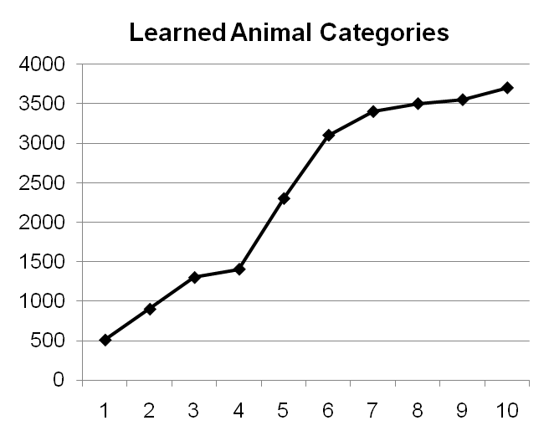
Results 1
Found staggering variety of terms!:
  Growth doesn’t stop!
  Example animals:
  accessories, activities, agents, amphibians, animal_groups, animal_life, amphibians, apes, arachnids, area, …, felines, fish, fishes, food, fowl, game, game_animals, grazers, grazing_animals, grazing_mammals, herbivores, herd_animals, household_pests, household_pets, house_pets, humans, hunters, insectivores, insects, invertebrates, laboratory_animals, …, water_animals, wetlands, zoo_animals
Much more diverse than expected:
  Probably useful: laboratory animals, forest dwellers, endangered species …
  Useful?: bait, allergens, seafood, vectors, protein, pests …
  What to do?: native animals, large mammals …
Problem: How to evaluate this?

Slide 52
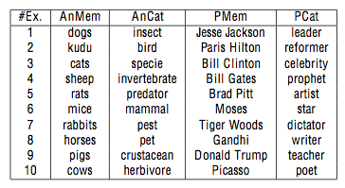
Evaluation: Are the learned classes really Animals / People?
Examples (top 10):
Subclasses/instances:
  Animals (evaluate against lists compiled from websites):
  People (ask human judges):
Iteration | 1 | 2 | 3 | 4 | 5 | 6 | 7 | 8 | 9 | 10
Accuracy | 0.79 | 0.79 | 0.78 | 0.70 | 0.68 | 0.68 | 0.67 | 0.67 | 0.68 | 0.71
 | Judge1 | Judge2 | Judge3
Person | 190 | 192 | 189
NotPerson | 10 | 8 | 11
Accuracy | 0.95 | 0.96 | 0.95

Slide 53
Results 2
Surprisingly, found many more classes than instances:
Intermediate concepts
Intermediate concepts
Basic level concepts
Instances
Animals
People

Slide 54
Evaluation woes: Precision
Would like to evaluate against WordNet or Wikipedia (international standards, available, large, etc.)
BUT:
  They do not contain many of our learned terms (even though many are sensible and potentially valuable)
  Point of our work is to learn more/new concepts than currently available
Other projects create ad hoc measures:
  E.g.: Ritter et al. learn jaguar ISA { animal, mammal, toy, sports-team, car-make, operating-system } and count all as correct — even if not Animal
Our strategy:
  Count only correct classes
  Compare against WordNet and do manual evaluation (if possible)

Slide 55
Evaluation woes: Recall
Cannot easily compare to WordNet:
  Doesn’t indicate Basic Level
  Doesn’t include Instances (very few proper names)
So, need to ask people … this is expensive

Slide 56
Evaluation measures
Precision:
  PrWN =
  PrHUM =
Recall substitute:
  NotInWN = #terms judged correct by human but not in WordNet
#terms found in WordNet
#terms harvested by system
#terms judged correct by human
#terms harvested by system

Slide 57
Evaluation: Basic terms and instances
 | # harvested | Pr_{WN} | Pr_{HUM} | NotInWN
Animals | 913 | .79 | .71 | 48
People | 1344 | .23 | .95 | 986
Animals: Precision at Rank N
People: Precision at Rank N

Slide 58
Challenge: Taxonomizing terms
Start: animals
NP0: amphibians apes … felines fish fishes food fowl game game_animals grazers grazing_animals grazing_mammals herbivores herd_animals household_pests household_pets house_pets humans hunters insectivores insects invertebrates laboratory_animals … monogastrics non-ruminants pets pollinators poultry predators prey … vertebrates water_animals wetlands zoo_animals
NP2: … alligators ants bears bees camels cats cheetahs chickens crocodiles dachshunds dogs eagles lions llamas … peacocks rats snails snakes spaniels sparrows spiders tigers turkeys varmints wasps wolves worms …
?

Slide 59
Yahoo example
Yellow Pages
Automotive
Legal
Health
Travel
…
Motorcycles
Cars
Washes
Dealers
Rental
Repair
…
Dealers
Rental
Parts
Repair
What kind of taxonomy structure?
…a real-world hierarchy is complex; not simple IS-A
Cal Coast
Champion
Q&E
Bothers
Harley House
Turbo Power
...
B&B Parts
Auto Home
Joe’s Shop
3 Brothers
AutoHaus
Mechtech
...
Cal Coast
Ccc ChaHire
Bothers
Har Budget
Turbo
...
West Brom
WeFixCars
Best Auto
Dave & Al
VW Special
...

Slide 60
Building the hierarchy
Ran DAP and DAP-1 in tandem (10 iterations)
  Learned 3,549 Animal and 4,094 People concepts
  Filter: In-degree ranking and freq cutoff
Evaluation:
  Random samples: 437 Animals and 296 People
  Of these, 187 Animal concepts and 139 People concepts passed ISA (Concept Positioning) Test
Taxonomization methods:
  Concept Positioning Test:
    (apply DAP twice, inverting)
    Count freqs of terms generated by each term pair
  Concept Children Test:
    Count intersections of terms generated by each term pair
[animals such as lions and *] ?
[lions such as animals and *] ?

Slide 61
Evaluating concepts
ANIMALS
TYPE | LABEL | EXAMPLES
Correct | GeneticAnimal | reptile,mammal
 | BehavioralByFeeding | predator, grazer
 | BehaviorByHabitat | saltwater mammal
 | BehaviorSocialIndiv | herding animal
 | BehaviorSocialGroup | herd, pack
 | MorphologicalType | cloven-hoofed animal
 | RoleOrFunction | pet, parasite
Borderline | NonRealAnimal | dragon
 | EvaluativeTerm | varmint, fox
 | OtherAnimal | critter, fossil
BasicConcept | BasicAnimal | dog, hummingbird
NotConcept | GeneralTerm | model, catalyst
 | NotAnimal | topic, favorite
 | GarbageTerm | brates, mals
PEOPLE
TYPE | LABEL | EXAMPLES
Correct | GeneticPerson | Caucasian, Saxon
 | NonTransientEventRole | stutterer, gourmand
 | TransientEventRole | passenger, visitor
 | PersonState | dwarf, schizophrenic
 | FamilyRelation | aunt, mother
 | SocialRole | fugitive, hero
 | NationOrTribe | Bulgarian, Zulu
 | ReligiousAffiliation | Catholic, atheist
Borderline | NonRealPerson | biblical figure
 | OtherPerson | colleagues, couples
BasicConcept | BasicPerson | child, woman
 | RealPerson | Barack Obama
NotConcept | GeneralTerm | image, figure
 | NotPerson | books, event
First checked whether learned intermediate concepts are correct
  Manually created small taxonomy to begin to group terms
  Also included categories for wrong and dubious terms
Then checked for ISA taxonomization using CPT

Slide 62
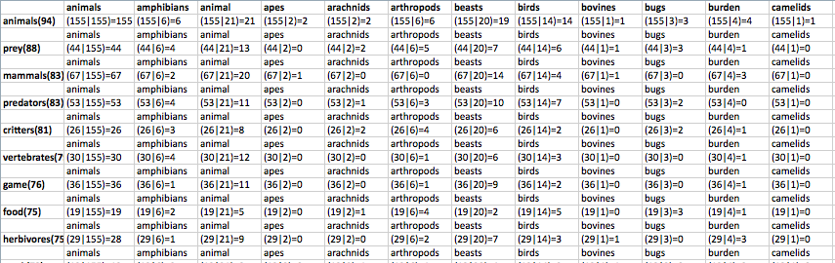
ISA relationship tests
[animals such as lions and *] ?
[lions such as animals and *] ?
Concept Positioning Test:
  (apply DAP twice, inverting terms)
  Count freqs of terms generated by each term pair
Concept Children Test:
  Count intersections of terms generated by each term pair
Notes:
62
We did not consider the intersections of the terms, so the Concept Children Test must be removed.

Slide 63
Evaluation of intermediate concepts
Human evaluation, 4 annotators
Comparison with WordNet
All concepts, before
Concept Positioning Test
Acc1 = % Correct
Acc2 = % Correct or Borderline
 | Animals |  |  |  | People
 | A1 | A2 | A3 | A4 | A1 | A2 | A3 | A4
Correct | 246 | 243 | 251 | 230 | 239 | 231 | 225 | 221
Borderline | 42 | 26 | 22 | 29 | 12 | 10 | 6 | 4
BasicConcept | 2 | 8 | 9 | 2 | 6 | 2 | 9 | 10
NotConcept | 147 | 160 | 155 | 176 | 39 | 53 | 56 | 61
Acc1 | 0.56 | 0.56 | 0.57 | 0.53 | 0.81 | 0.78 | 0.76 | 0.75
Acc2 | 0.66 | 0.62 | 0.62 | 0.59 | 0.85 | 0.81 | 0.78 | 0.76
 | Animals after CPT |  |  |  | People after CPT
 | A1 | A2 | A3 | A4 | A1 | A2 | A3 | A4
Correct | 146 | 133 | 144 | 141 | 126 | 126 | 114 | 116
Borderline | 11 | 15 | 9 | 13 | 6 | 2 | 2 | 0
BasicConcept | 2 | 8 | 9 | 2 | 0 | 1 | 7 | 7
NotConcept | 28 | 31 | 25 | 31 | 7 | 10 | 16 | 16
Acc1 | 0.78 | 0.71 | 0.77 | 0.75 | 0.91 | 0.91 | 0.82 | 0.83
Acc2 | 0.84 | 0.79 | 0.82 | 0.82 | 0.95 | 0.92 | 0.83 | 0.83
Good concepts after
Concept Positioning Test
 | # harvested | Pr_{WN} | Pr_{HUM} | NotInWN
Animals | 437 | .20 | .57 | 204
People | 296 | .51 | .85 | 108
Notes:
Should we put Evaluation of Intermediate Concepts?

Slide 64
Evaluation of IS-A links
Accuracy of algorithm on taxonomy links?
Very expensive to consider all links
  Need concept disambiguation in Wordnet
  Need manual inspection of each term
Consider only links from instance/basic level to immediate parent:
 | # harvested | Pr_{WN} | Pr_{HUM} | NotInWN
Animals | 1940 | .47 | .88 | 804
People | 908 | .23 | .94 | 539
WordNet lacks nearly half of the ISA links!

Slide 65
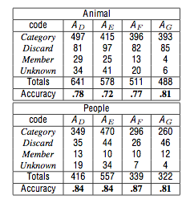

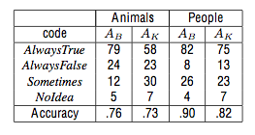
Human evaluation
First check if terms are correct:
  3 human judges; used web to check
  Good answer = Category; inverse ISA = Member; bad term = Discard
  Very high pairwise Cohen kappas
Then evaluate ISAs:
  Randomly selected 120 each (Animal and People) relations (100 from harvesting; 20 made at random to include some False answers)
  3 humans judges; asked if instance always / sometimes / never under supercategory
  Average pairwise Cohen kappa = 0.71 (animals) and 0.84 (people)

Slide 66
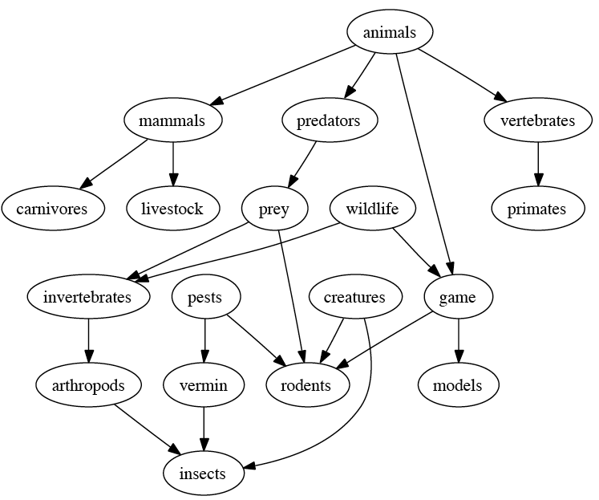
Still…results are a bit of a mess
The problem?
Too many different kinds of categories

Slide 67
Solution: Group classes into small sets
(Kozareva et al. 09)
First, created a small Upper Model manually:
Then, had 4 independent annotators choose appropriate Upper Model class(es) for several hundred harvested classes
Kappa agreement for some classes ok, for others not so good
  Sometimes quite difficult to determine what an animal term means
BasicAnimal
BehaviorByFeeding
GeneticAnimalClass
RealAnimal
BehaviorByHabitat
BehaviorClasses
BehaviorBySocialization
GeneralTerm
MorphologicalTypeAnimal
NonRealAnimal
RoleOrFunctionOfAnimal
EvaluativeAnimalTerm

Slide 68
1. BasicAnimal
The basic individual animal. Can be visualized mentally. Examples: Dog, Snake, Hummingbird.
2. GeneticAnimalClass
A group of basic animals, defined by genetic similarity. Cannot be visualized as a specific type. Examples: Reptile, Mammal. Note that sometimes a genetic class is also characterized by distinctive behavior, and so should be coded twice, as in Sea-mammal being both GeneticAnimalClass and BehavioralByHabitat. (Since genetic identity is so often expressed as body structure—it’s a rare case that two genetically distant things look the same structurally—it will be easy to confuse this class with MorphologicalTypeAnimal. If the term refers to just a portion of the animal, it’s probably a MorphologicalTypeAnimal. If you really see the meaning of the term as both genetic and structural, please code both.)
3. NonRealAnimal
Imaginary animals. Examples: Dragon, Unicorn. (Does not include ‘normal’ animals in literature or films.)
4. BehavioralByFeeding
A type of animal whose essential defining characteristic relates to a feeding pattern (either feeding itself, as for Predator or Grazer, or of another feeding on it, as for Prey). Cannot be visualized as an individual animal. Note that since a term like Hunter can refer to a human as well as an animal, it should not be classified as GeneralTerm.
5. BehavioralByHabitat
A type of animal whose essential defining characteristic relates to its habitual or otherwise noteworthy spatial location. Cannot be visualized as an individual animal. (When a basic type also is characterized by its spatial home, as in South African gazelle, treat it just as a type of gazelle, i.e., a BasicAnimal. But a class, like South African mammals, belongs here.) Examples: Saltwater mammal, Desert animal. And since a creature’s structure is sometimes determined by its habitat, animals can appear as both; for example, South African ruminant is both a BehavioralByHabitat and a MorphologicalTypeAnimal.
6. BehavioralBySocializationIndividual
A type of animal whose essential defining characteristic relates to its patterns of interaction with other animals, of the same or a different kind. Excludes patterns of feeding. May be visualized as an individual animal. Examples: Herding animal, Lone wolf. (Note that most animals have some characteristic behavior pattern. So use this category only if the term explicitly focuses on behavior.)

Slide 69
7. BehavioralBySocializationGroup
A natural group of basic animals, defined by interaction with other animals. Cannot be visualized as an individual animal. Examples: Herd, Pack.
8. MorphologicalTypeAnimal
A type of animal whose essential defining characteristic relates to its internal or external physical structure or appearance. Cannot be visualized as an individual animal. (When a basic type also is characterized by its structure, as in Duck-billed platypus, treat it just as a type of platypus, i.e., a BasicAnimal. But a class, like Armored dinosaurs, belongs here.) Examples: Cloven-hoofed animal, Short-hair breed. And since a creature’s structure is sometimes determined by its habitat, animals can appear as both; for example, South African ruminant is both a MorphologicalTypeAnimal and a BehavioralByHabitat. Finally, since genetic identity is so often expressed as structure—it’s a rare case that two genetically distant things look the same structurally—it will be easy to confuse this class with MorphologicalTypeAnimal. If the term refers to just a portion of the animal, it’s probably a MorphologicalTypeAnimal. But if you really see both meanings, please code both.
9. RoleOrFunctionOfAnimal
A type of animal whose essential defining characteristic relates to the role or function it plays with respect to others, typically humans. Cannot be visualized as an individual animal. Examples: Zoo animal, Pet, Parasite, Host.
G. GeneralTerm
A term that includes animals (or humans) but refers also to things that are neither animal nor human. Typically either a very general word such as Individual or Living being, or a general role or function such as Model or Catalyst. Note that in rare cases a term that refers mostly to animals also includes something else, such as the Venus Fly Trap plant, which is a carnivore. Please ignore such exceptional cases. But when a large proportion of the instances of a class are non-animal, then code it as GeneralTerm.
E. EvaluativeAnimalTerm
A term for an animal that carries an opinion judgment, such as “varmint”. Sometimes a term has two senses, one of which is just the animal, and the other is a human plus a connotation. For example, “snake” or “weasel” is either the animal proper or a human who is sneaky; “lamb” the animal proper or a person who is gentle, etc. Since the term can potentially carry a judgment connotation, please code it here as well as where it belongs.
A. OtherAnimal
Almost certainly an animal or human, but none of the above applies, or: “I simply don’t know enough about it”.

Slide 70
Taxonomization evaluation 1: Animals
Human Judgment for Animal
 | A1 | A2 | A3 | A4 | K
BasicAnimal | 29 | 24 | 13 | 4 | .51
BehByFeeding | 48 | 33 | 45 | 49 | .68
BehByHabitat | 85 | 58 | 56 | 54 | .66
BehBySocGroup | 1 | 2 | 6 | 7 | .47
BehBySocInd | 5 | 4 | 1 | 0 | .46
EvaluativeTerm | 41 | 14 | 10 | 29 | .51
Garbage Term | 21 | 12 | 15 | 16 | .74
GeneralTerm | 83 | 72 | 64 | 79 | .52
GeneticAnimal | 95 | 113 | 81 | 73 | .61
MorphTypeAnimal | 29 | 33 | 42 | 39 | .58
NonRealAnimal | 0 | 1 | 0 | 0 | .50
NotAnimal | 81 | 97 | 82 | 85 | .68
OtherAnimal | 34 | 41 | 20 | 6 | .47
Role/FunctAnimal | 89 | 74 | 76 | 47 | .58
Total | 641 | 578 | 511 | 488 | .57
MorphologicalTypeAnimal
A type of animal whose essential defining characteristic relates to its internal or external physical structure or appearance.
Cannot be visualized as an individual animal.
Examples: Cloven-hoofed animal, Short-hair breed. A creature’s structure is sometimes determined by its habitat, animals can appear as both; South African ruminant is both MorphologicalTypeAnimal and BehavioralByHabitat. Genetic identity is so often expressed as structure—it’s a rare case that two genetically distant things look the same structurally—it will be easy to confuse this class with MorphologicalTypeAnimal. If the term refers to just a portion of the animal, it’s probably a MorphologicalTypeAnimal. But if you really see both meanings, please code both.
GeneticAnimalClass
A group of basic animals, defined by genetic similarity.
Cannot be visualized as a specific type.
Examples: Reptile, Mammal. Note that sometimes a genetic class is also characterized by distinctive behavior, and so should be coded twice, as in Sea-mammal beingboth GeneticAnimalClass and BehavioralByHabitat. (Since genetic identity is so often expressed as body structure—it’s a rare case that two genetically distant things look the same structurally—it will be easy to confuse this class with MorphologicalTypeAnimal. If the term refers to just a portion of the animal, it’s probably a MorphologicalTypeAnimal. If you really see the meaning of the term as both genetic and structural, please code both.)
BehavioralByHabitat
A type of animal whose essential defining characteristic relates to its habitual or otherwise noteworthy spatial location.
Cannot be visualized as an individual animal. (When a basic type also is characterized by its spatial home, as in South African gazelle, treat it just as a type of gazelle, i.e., a BasicAnimal. But a class, like South African mammals, belongs here.)
Examples: Saltwater mammal, Desert animal. A creature’s structure is sometimes determined by its habitat, animals can appear as both; South African ruminant is both BehavioralByHabitat and MorphologicalTypeAnimal.
GeneralTerm
A term that includes animals (or humans) but refers also to things that are neither animal nor human. Typically either a very general word such as Individual or Living being, or a general role or function such as Model or Catalyst.
Note that in rare cases a term that refers mostly to animals also includes something else, such as the Venus Fly Trap plant, which is a carnivore. Please ignore such exceptional cases.
BehavioralBySocializationIndividual
A type of animal whose essential defining characteristic relates to its patterns of interaction with other animals, of the same or a different kind. Excludes patterns of feeding.
May be visualized as an individual animal.
Examples: Herding animal, Lone wolf. (Note that most animals have some characteristic behavior pattern. So use this category only if the term explicitly focuses on behavior.)
EvaluativeAnimalTerm
A term for an animal that carries an opinion judgment, such as “varmint”. Sometimes a term has two senses, one of which is just the animal, and the other is a human plus a connotation.
For example, “snake” or “weasel” is either the animal proper or a human who is sneaky; “lamb” the animal proper or a person who is gentle, etc.
RoleOrFunctionOfAnimal
A type of animal whose essential defining characteristic relates to the role or function it plays with respect to others, typically humans.
Cannot be visualized as an individual animal.
Examples: Zoo animal, Pet, Parasite, Host.
BehavioralBySocializationGroup
A natural group of basic animals, defined by interaction with other animals.
Cannot be visualized as an individual animal.
Examples: Herd, Pack.
BehavioralByFeeding
A type of animal whose essential defining characteristic relates to a feeding pattern (either feeding itself, as for Predator or Grazer, or of another feeding on it, as for Prey).
Cannot be visualized as an individual animal.
Note that since a term like Hunter can refer to a human as well as an animal, it should not be classified as GeneralTerm.
BasicAnimal
The basic individual animal.
Can be visualized mentally.
Examples: Dog, Snake, Hummingbird.
GarbageTerm
Not a real English word.

Slide 71
Taxonomization evaluation 2: People
Human Judgement People
 | An1 | An2 | An3 | An4 | K
BasicPerson | 5 | 6 | 1 | 3 | .55
FamilyRelation | 7 | 6 | 7 | 6 | .86
GeneralTerm | 38 | 12 | 21 | 12 | .50
GeneticPersonCl | 1 | 2 | 1 | 0 | .44
ImaginaryPeople | 14 | 16 | 5 | 2 | .47
NationOrTribe | 2 | 3 | 3 | 2 | .78
NonTranEventPar | 29 | 63 | 41 | 32 | .57
NotPerson | 31 | 31 | 28 | 38 | .80
OtherHuman | 4 | 5 | 0 | 2 | .50
PersonState | 23 | 1 | 25 | 1 | .47
RealPeople | 1 | 7 | 1 | 0 | .50
ReligiousAffiliation | 10 | 16 | 12 | 15 | .61
SocialRole | 62 | 61 | 39 | 44 | .61
TransientEventPar | 30 | 27 | 13 | 7 | .48
Total | 257 | 256 | 197 | 164 | .58
Class definition
GeneticPersonClass
A person or persons defined by genetic characteristics/similarity.
Can be visualized as a specific type.
Examples: Asian, Saxon.
NonTransientEventParticipant
The role a person plays consistently over time, by taking part in one or more specific well-defined events. This class distinguishes from PersonState, since there is always an associated characteristic action or activity that either persists or recurs, without a specific endpoint being defined.
The group includes several types: Occupations (priest, doctor), Hobbies (skier, collector), Habits (stutter, peacemaker).
TransientEventParticipant
The role a person plays for a limited time, through taking part in one or more specific well-defined events. There is always an associated characteristics action or activity, with a defined endpoint.
Example: speaker, passenger, visitor.
PersonState
A person with a certain physical or mental characteristic that persists over time. Distinguishing this class from NonTransientEventParticipant, there is no typical associated defining action or activity that one can think of.
Example: schizophrenic, AIDS patient, blind person.

Slide 72
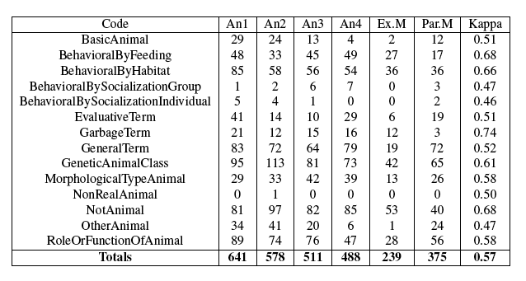
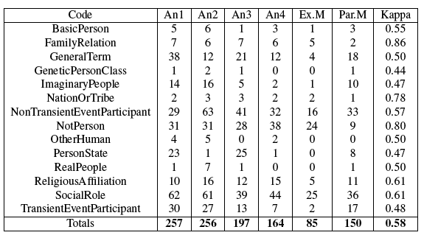
Human category judgments
Animals
People

Slide 73
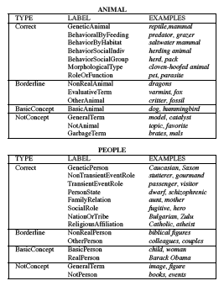
Simplifying intermediate classes
Agreement still low…
So: Grouped sets into 4 set categories
Used same 4 humans
Pairwise inter-annotator agreement (Fleiss kappa, Fleiss 71):
  Animals 0.61–0.71 (avg 0.66)
  People 0.51–0.70 (avg 0.60)

Slide 74
More taxonomies… still not so great…
Another animal taxonomy:
Emotions—a disaster!

Slide 75
Higher-level concepts and abstractions

Slide 76
Goals, plans, and other types
Intuition: Language is interpreted at many levels:
  Basic conceptual: entities, events, states
  Advanced conceptual: scripts, plans, goals…
  Social: interpersonal aspects
Many aspects of semantics require higher-level bridging interpretations/anomaly detection
At least, we need plans and goals

Slide 77


The canary in the coal mine

Slide 78
Taxonomies of plans and goals

Slide 79
Inference

Slide 80
Goal: Detect anomalous events
Slide by Yang, Carbonell, Hsi
Novel = first report, not seen before, not co-referential
  Ingredients: similarity fn, event history, co-reference, …
Anomalous = unexpected or surprising event, whether 1st or subsequent mention
  Ingredients: frame parsing, event history, semantic similarity fn, co-reference, …
Event | Novel? | Anomalous?
Two Syrian soldiers shot by rebels (1st mention) | Yes (new) | No (expected)
Two soldiers in Syria shot by rebels (5th mention) | No (old) | No (expected)
Congresswoman Gifford shot in Arizona (1st mention) | Yes (new) | Yes (surprising)
Shooting of Congresswoman in Arizona (5th mention) | No (old) | Yes (surprising)

Slide 81
Must go beyond single slot-fillers
Anomaly occurs with an unexpected or unusual combination of semantic role fillers at the right level
Cannot just look at lexical level; level of generality of slot fillers is important:
  [Two soldiers] [shooting] [one another] => normal
  [People] [shooting] [one another] => normal
  [Soldiers] [shooting] [in a military camp] => normal
  [Soldiers] [shooting] [anywhere] => normal
  [Two soldiers of the same country] [shooting] [one another] => ?abnormal
Cannot look at slot fillers in isolation: combination is important:
  [Two soldiers of the same country] [shooting] [one another] [in a military camp] => abnormal

Slide 82
Approach: Neural Event Model NEM
Dasigi and Hovy, COLING 2014
Approach:
  Identify event plus its core facets
  Represent words using distributional semantics
    Experiment with embeddings, tensors, etc.
  Train RNN to recognize typical facet combinations
  For new event, apply RNN to measure degree of ‘unusualness’
Corpus and evaluation:
  Created corpus from weird news headlines
  Validated with Amazon MTurk

Slide 83
Training data
Gigaword Headlines
US Senate vote on Bonsia “internal” matter says Juppe
Japanese expect profits to recover after dismal year
Ottawa gives a new chance to refugees threatened with deportation
Gulf Air sees record year, expands to Asia
“Weird” news headlines
Missing woman found dead behind bookcase
Sea lion bites at least 14 at California lagoon
India weaponizes world’s hottest chili
Man recovering after being shot by his dog
Source: NBC News www.nbcnews.com/news/weird-news/, 3684 headlines

Slide 84
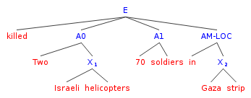
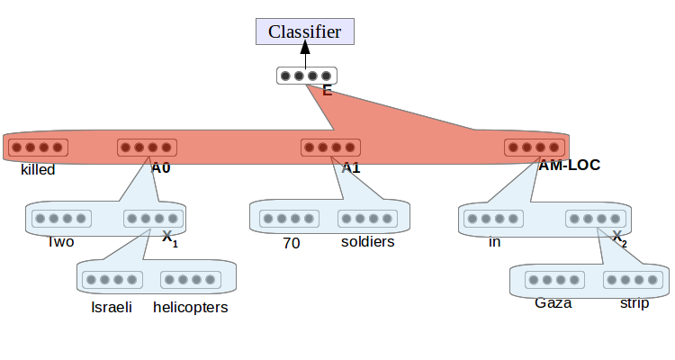
Neural Event Model
Event structure obtained by SRL
Two-stage RNN training:
  1. Each role filler from the NPs
  2. Entire sentence from the fillers
Anomaly decision: Logistic regression at top, to classify if event is anomalous

Slide 85
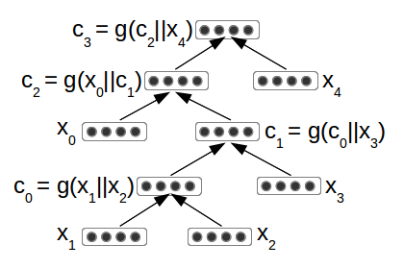



Training 1: Argument composition
Phase 1: Recursive Neural Networks (Goller and Küchler, 1996; Socher et al., 2012)
  RNN structured deep neural network backed by a tree structure
  Training done using back-propagation
  Parameters for each argument: W_{arg}, b_{arg}, S_{arg}, V
Training objective similar to Contrastive Estimation (Smith and Eisner, 2005): replace a part of a normal sentence to achieve an abnormal one:
  s = score(Two Israeli helicopters killed 17 soldiers)
  s = score(Two persuade helicopters killed 17 soldiers)
[Back]propagate to make sure the abnormal one is scored less

Slide 86
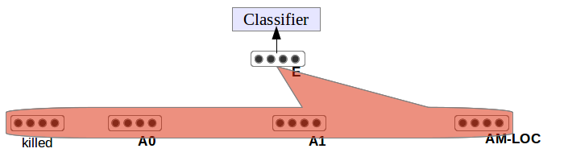
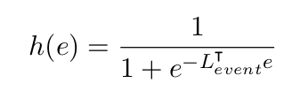
Training 2: Event composition
Phase 2: Tried auto-encoding: no success
Supervised: Learn to differentiate between anomalous events and normal ones
  Logistic regression with event embedding as features
  Back-propagation to learn event composition parameters so as to classify anomaly
  Parameters: W_{event} b_{event} L_{event}
  e = g(C_{V} || C_{Arg0} || C_{Arg1} || C_{ArgM-LOC} || C_{ArgM-TMP})

Slide 87
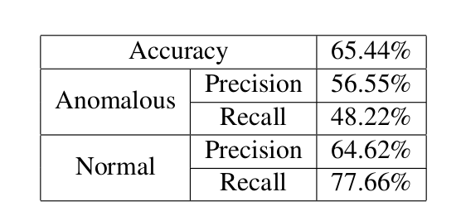
Classification results
Binary classifier tested against human annotations
Cannot Say removed from test data, Strange and Highly Unusual merged
Precision of random classifier in classifying anomaly expected to be 41% (percentage of events labeled anomalous)

Slide 88
Some qualitative results
System labeled anomalous
Test Data
  Dog with college degree (A0) appears (V) in court (LOC)
  Woman (A0) eats (V) ex's goldfish (A1) after spat (TMP)
IC Corpus
  Group that bombed Madrid (A0) linked (V) to Al-Qaeda, Morocco attacks (A1)
  Town council member (A0) shot (V) as car bomb kills three (TMP)
System labeled normal
Test Data
  Redcross International committee (A0) quit (V) Hongkong (A1) after 1997 (TMP)
  58 (A0) wounded (V) in Azerbaijan revolt (LOC)
IC Corpus
  Three Palestinian militants (A1) killed (V) by Israeli troops (A0) in Gaza (LOC)
  Heavy fighting (A0) reported (V) in breakaway Somaliland (LOC)

Slide 89
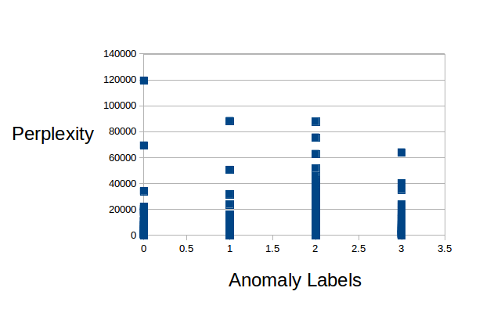
Baselines
Can the same results be obtained by simpler means?
Experiment 1: Language model preferences:
  Built two LMs (for normal and anomalous sentences)
  Datasets same as the ones used for training NEM
  Classified each sentence according to which model likes it better:
Experiment 2: Perplexity:
  Built LM from large corpus
  Compared perplexities
  No clear perp. difference between normal and anomalous sentences
 | Language Models | NEM
Classification accuracy | 49.6 | 65.4
Anomaly precision | 39.5 | 56.5

Slide 90
Confirming the test data
Gave test data (incl. weird news) to human annotators from MTurk
HIT required choosing one of four options for each event:
  Highly unusual if the event seemed too strange to be true
  Strange if the event seemed unusual but plausible
  Normal
  Cannot say if the information provided is not sufficient to make a decision
Number of events | 1003
Number of annotators | 22
Avg events per annotator | 344
Normal | 56.3%
Strange | 28.6%
Highly Unusual | 10.3%
Cannot Say | 4.8%
4-way IAA (α) | 0.34
3-way IAA (α) | 0.56

Slide 91
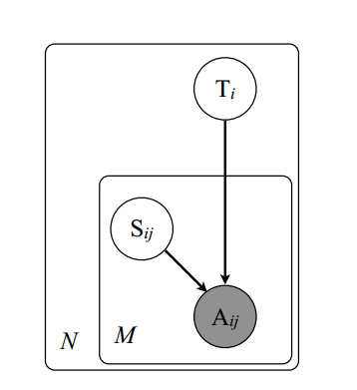
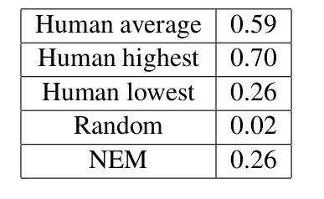
Comparison with humans using MACE
Model performance tested against human annotators
MACE: Uses EM to infer (latent) true labels and annotator “competence” given observed labels
Model predictions compared to annotators:
MACE
Equals lowest-ranked human
Image Source: Learning Whom to Trust with MACE, Hovy et al., NAACL 2013

Slide 92
Unsupervised model
Also trained autoencoder with objective function to minimize Euclidean distance between input and reconstruction
In anomalousness order, from 1000 sentences (mixed normal and anomalous, in-domain and weird news):
  Woman makes threat to delay flight
  Woman admits selling 2 kids for 1 bird , $175
  India , Bangladesh agree on water-sharing pact
  Woman gets call about her own funeral
  Doctor fires patient who wouldn’t sign petition
  China bestows May Day gongs on ‘model worker’ business owners
  Two Sikorsky troop carriers collided as they were flying to the occupied zone in south Lebanon over northern Israel
  Bulgarian Socialists to elect new leader
  A US soldier shot 12 US soldiers and wounded another 30 in a US Army Base , Ft Hood

Slide 93
Conclusion and thoughts from today’s talks

Slide 94
Entities vs events in the long tail
Events are much more frequent than entities:
  Most entities have names (= their words) while most events don’t (they are configurations of entities) (exceptions: Brexit, WW II, this workshop...)
  So there are many many more event instances
  So event instances tend to live in the tail more than (major-sense entities) do (they are each much less frequent)
Implication: focus on events
  Nice property: They involve characteristic combinations of entities, and the specific entity combination helps to define each event

Slide 95
Micro-contexts
The long tail contains lots of different phenomena
Most of them (?) relate to semantics — we use semantic reasoning to resolve unknowns
The notion of a micro-context is useful:
  A small packet of information specifically relevant to a given text situation
  Words and correct senses, denotations and coref, typical event roles and default fillers…
Problem: We can’t create them in advance!

Slide 96
Making and using micro-contexts
Background knowledge preparation:
  Create many microtheories (time, locations, etc.)
  Create a fact base (like PropStore + a case base)
Run-time: For a given story, instantiate its micro-context(s):
  Not just scripts and plans, but dynamically built ‘packets’
  Extract and build from background knowledge…

Slide 97
Maarten’s talk today
“Stick to the natural distribution” — This means: “Keep the word distribution in your main system and apply micro-context later”
  Example: Obama (the President) vs Obama (the city in Japan): each comes with its own associated words
  Create the micro-context when an Obama-as-city story comes
  Maarten creates a micro-context ‘outside’ the data: learns to rerank using the micro-context’s specific associated words to ‘pull higher’ the long-tail reading

Slide 98
Antal’s talk today
“The long tail is where tokens become types”
  (Though it is also where the [ambiguous] tokens with a non-dominant sense reside, who are overshadowed by the dominant sense)
  Assign higher probabilities to micro-context words (those in the cache) — treat the token as a type
Creating the micro-context: Map known <—> unknown using analogical reasoning
  Learn to [analogically] transform tokens/types from unknown to known (or vice versa) — k-NN clusters of various facets
  But not all transformations work: abstraction is dangerous!
  “Forgetting exceptions is harmful” — because they guide you!

Slide 99
Johan’s talk today
“The long tail…is very long”
  => There are many many micro-contexts
  Though the tail gets proportionally smaller (in tokens) as the corpus grows … still over 40% in 1M+ corpus
  Morphemic decomposition is one transformation method (known <—> unknown)
The 80-20 rule means our hard work is only starting
  So we have to be clever in choosing our work!
  No: scope, quantification
  Yes: anaphora, substantive adjectives (“tall”, etc.), comparatives, entity linking (like Wikification), time

Slide 100
Ivan’s talk
“Representations defined by linguists are not appropriate for reasoning” — we need to make our representations useful for applications
So: Do [un]supervised frame induction:
  Though many problems
  “Need to use smarter dynamic models”
Frame+role induction framework:
  Approach with joint model
  Problem: still need feature enrichment for the tail
This is an important part of micro-context construction!

Slide 101
Stefan’s talk
People publish operational data on the Semantic Web (thanks to a strong formal logical foundation)
So there is no long tail problem!
BUT: Formal theory does not apply for the info in the long tail — it is too complex, nuanced, and varied
Toward a fix:
  Laundromat to clean + republish online triple stores
  Difficulty: Individual loose triples are not useful. But datasets create micro-context. Can link / cluster them
  Many datasets in the long tail!

Slide 102
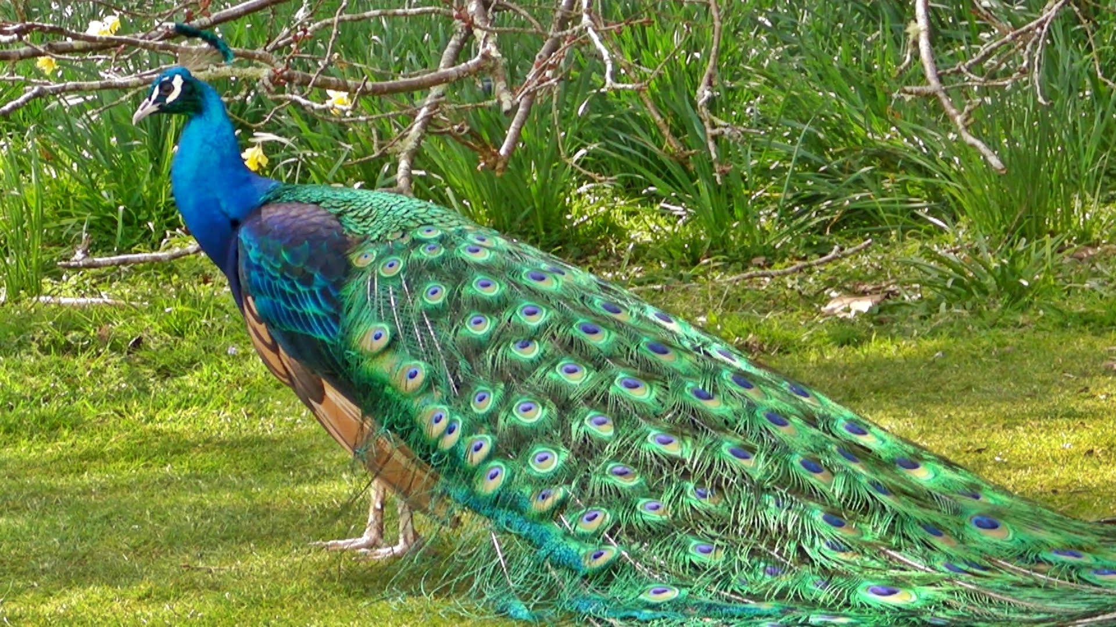
The long tail is long but rich
Many different types of representation
and many different types of reasoning
Micro-contexts may help
There is a joyous richness to keep us busy!
What’s in them? How to make them? How to know which one(s) to use?

